Slide 1
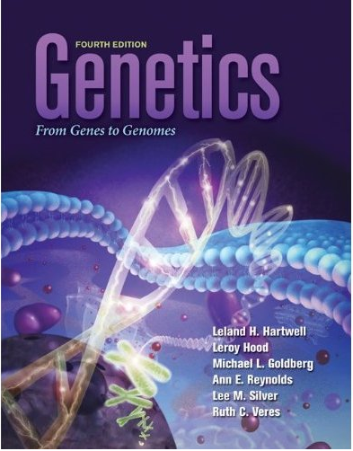
Chapter 6
Genetic Analysis in Prokaryotes
Jian Lu

Slide 2
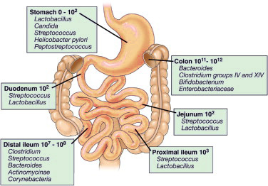

We are 57% microbes and 43% humans
A 70kg male has 3x10¹³ human cells and 3.8 x10¹³ microbial cells.
Almost every epithelial surface of our body contains a complex microbial community
Microbes can live even in the highly acidic environment of the stomach (pH=2).
4. Human gut microbiota includes at least 1000
different species of known bacteria with more
than 3 million genes
5. Microbiota weigh up to 2 kg.
One third of our gut microbiota is common to most people, while two thirds are specific to each one of us.

Slide 3
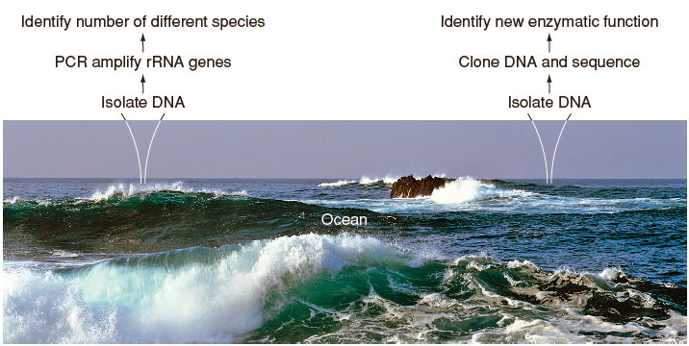
Meta-genomics: New analyses for assessing microbial diversity
Fig. 14.10
Bacteria in extreme environments are difficult to culture in lab
Large-scale PCR amplification and next generation sequencing can be used to survey composition of microbial communities and metabolic status

Slide 4
Meta-genomics: New analyses for assessing microbial diversity

Slide 5
Meta-genomics: New analyses for assessing microbial diversity

Slide 6
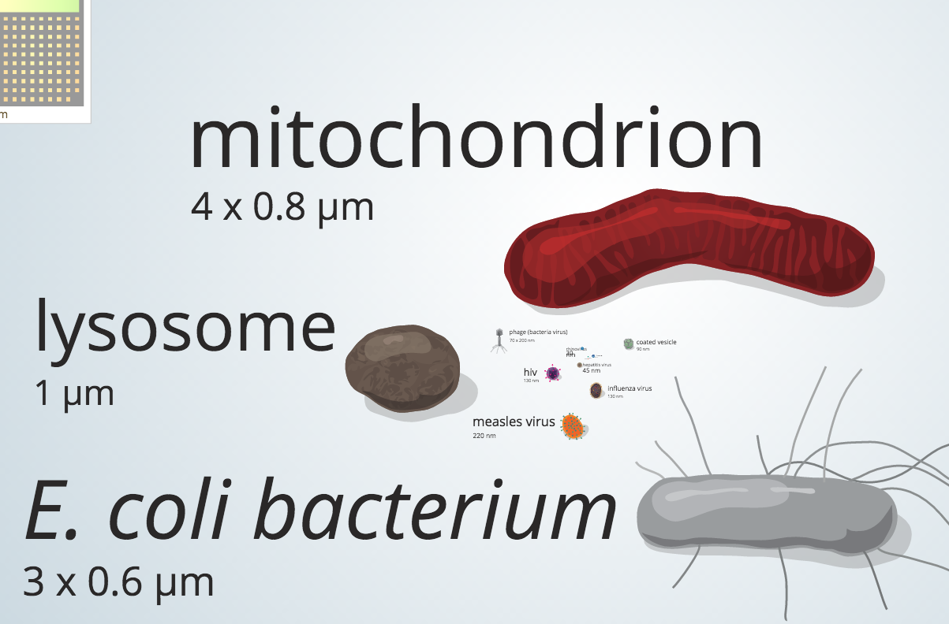
Vast range of bacteria sizes
Smallest has 200 nm diameter
Largest is 500 μm in length
Endosymbiotic Theory

Slide 7
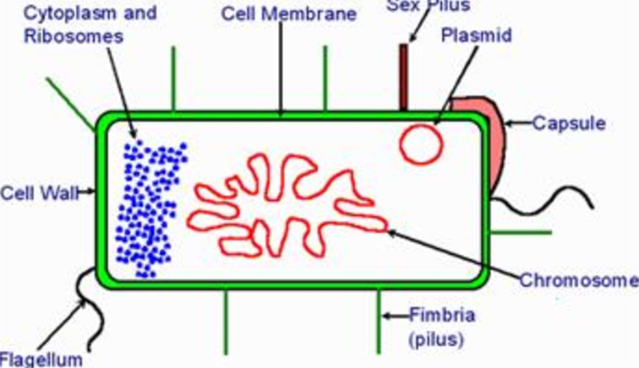
Bacteria sizes and characteristics
All bacteria are prokaryotes, which lack a defined nuclear membrane
All bacteria lack membrane-bounded organelles
Unlike the linear DNA of most eukaryotes, typical bacterial chromosomes are circular
4. Bacterial chromosomes fold to form a nucleoid body that excludes ribosomes
5. Most bacteria have a cell wall made of carbohydrate and peptide polymers that surrounds the cell membrane

Slide 8
Basic knowledge of Bacteria
Can be rapidly grown in large quantities
Cells divide by binary fission
Growth medium
liquid
solid, such as nutrient agar
Colony: asexual descendants of single cell
Prototroph（autotroph, “self-feeding”，原养型，即野生型）: wild-type bacterium that produces colonies on minimal medium（基本培养基）
Auxotroph（“outside-feeding”，营养缺陷型）: mutant that requires one or more nutrients in addition to minimal medium

Slide 9
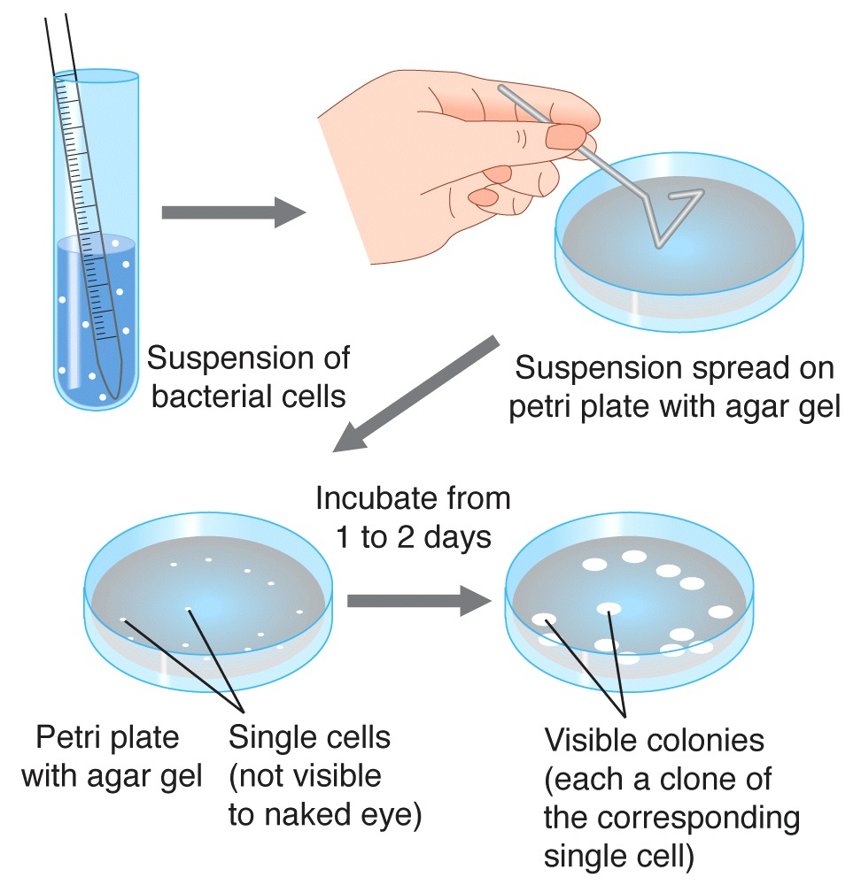
Bacteria must be grown and studied in cultures

Slide 10
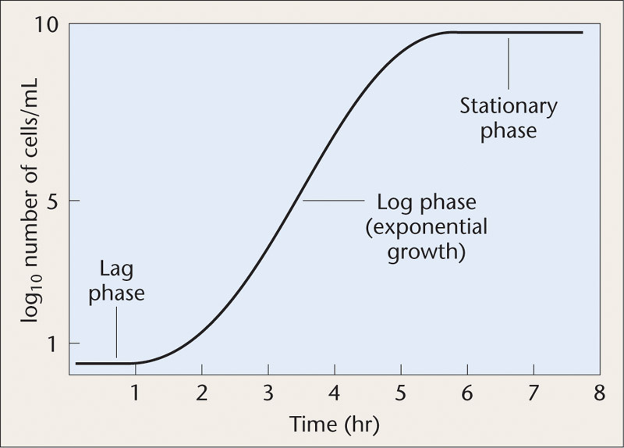
A typical bacterial population growth curve

Slide 11
Studies of bacteria were critical to the development of the field of genetics
Classical bacterial genetics – 1940s to 1970s
Virtually all knowledge of gene structure, expression, and regulation came from studies of bacteria and bacteriophages
Advent of recombinant DNA technology – 1970s and 1980s
Depended on understanding of bacterial genes, chromosomes and restriction enzymes

Slide 12
Escherichia coli (E. coli) is a versatile model organism
E. coli is the most studied and best understood bacterial species
Inhabits intestines of warm-blooded animals
Can grow in complete absence of oxygen or in air
Lab strains are not pathogenic, but other strains can cause variety of intestinal diseases
Prototrophic, can grow in minimal media
Single carbon and energy source (e.g. glucose)
Inorganic salts

Slide 13
Phenotypes of bacterial mutations
Altered colony morphology
Large or small; shiny or dull; round or irregular
Resistance to bactericides
Antibiotics, bacteriophages
Auxotrophs – unable to reproduce in minimal media
Defective in enzymes required to synthesize complex compounds (e.g. amino acids, nucleotides)
Defective in using complex chemicals from the environment
Example - breaking down lactose into glucose and galactose
Defective in proteins essential for growth
Conditional lethal mutations, e.g. temperature-sensitive (ts)

Slide 14
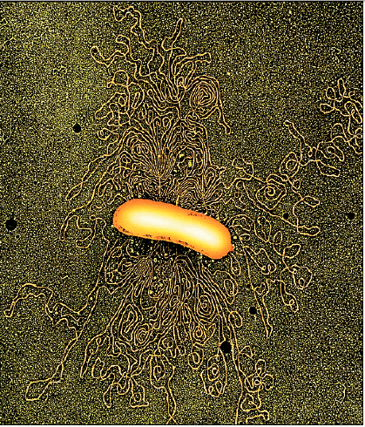
The E. coli genome was sequenced in 1997
Genome of K12 strain was sequenced
4.6 Mb
~ 90% of genome encodes protein
4288 genes, but function known for only 60%
On average, 1 gene per kb
No introns
Very little repetitive DNA
Small intergenic regions
Fig. 14.6

Slide 15
Gene nomenclature
Usually 2-3 letters with “⁺” or “–” symbol
Prototrophy / auxotrophy
met ⁺: can synthesize methionine, a wild-type prototroph
met –: requires methionine, a mutant auxotroph
Energy extraction
gal ⁺: can utilize galactose, wild-type
gal –: can not utilize galactose, a mutant
Drug resistance
str ^{r}: resistant to streptomycin in medium
str ^{s}: sensitive to streptomycin in medium (wild type)

Slide 16
Finding mutations in bacterial genes
Rapid bacterial multiplication allows detection of very rare genetic events
In minimal media, bacteria divide every 60 min
In rich media, bacteria divide every 20 minutes
Effectively haploid – straightforward relationship between mutation and phenotypic variation
Selection – establish conditions in which only the desired mutant will grow
e.g. Select for streptomycin (链霉素) resistance (Str^{r}) by plating on media containing streptomycin,
Screen – examine each colony for a particular phenotype

Slide 17
Techniques used to identify rare mutants
Spontaneous mutations in specific bacterial genes occur very rarely (1 in 10⁶ to 1 in 10⁸)
1. Replica plating – simultaneous transfer of thousands of colonies from one plate to another
2. Mutagens – used to increase the frequency of mutations
3. Enrichment – increases the proportion of mutant cells
e.g. Penicillin kills only cells that are dividing but not cells that are unable to divide
4. Testing for visible phenotypes
e.g. β-galactosidase from wild-type lacZ gene breaks down X-Gal substrate into a blue pigment

Slide 18
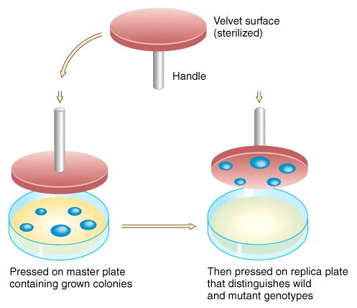
Replica plating
Fig. 14.4

Slide 19
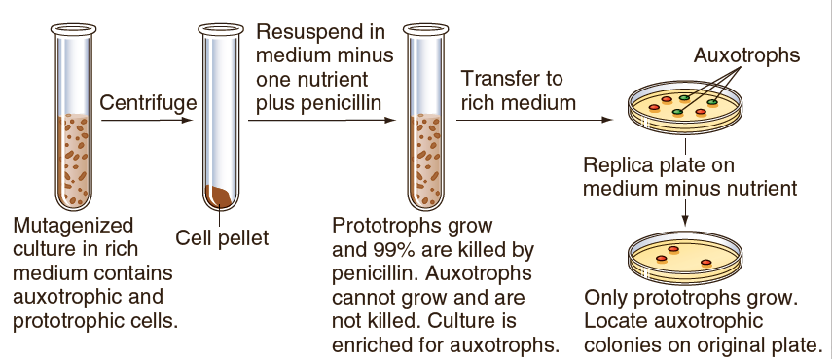
Penicillin enrichment for auxotrophic mutants
Fig. 14.4

Slide 20
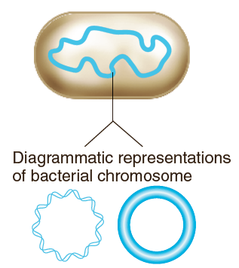
The typical bacterial genome is composed of one circular chromosome
4 to 5 Mb of DNA in most commonly studied bacterial species
DNA molecule condenses by supercoiling and looping
Each bacterium replicates and then divides by binary fission into two daughter cells
Fig. 14.5

Slide 21
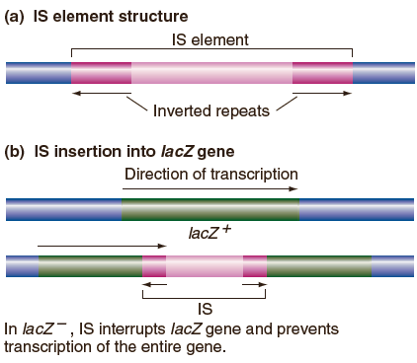
Insertion sequence (IS) elements dot the genomes of many types of bacteria
Bacterial strains have different numbers and distributions of IS elements
e.g. 15-25 in E. coli, none in B. subtilis
Small transposable elements (700-5000 bp length)
Inverted repeats (IRs) at ends
Carry transposase gene
Can move to other locations in genome
Can disrupt genes by insertion into coding regions (Fig 14.7b)
Fig. 14.7a

Slide 22
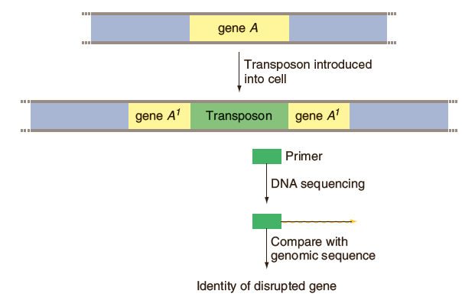
Identifying a gene that is disrupted by insertion of an IS element
inverse PCR
Fig. 14.9

Slide 23
Genomic analyses in bacteria have created an information explosion
Complete genome sequence known for thousands of prokaryotic species
New avenues of research are possible with genome studies
Metagenomics – analysis of genomic DNA from a community or habitat
Comparative genome analysis – identify similarities and differences between genomes of different species
Genome studies and public health – aid in development of vaccines, identify new drug targets, identify specific bacterial strains in epidemiological studies

Slide 24
Plasmids are smaller circles of DNA that carry genes beneficial to the host cell
Plasmids vary in size from 1 kb to several Mb in length
Plasmids don't carry genes that are essential to the host
Examples of plasmid genes that are beneficial to the host
Genes that protect host against toxic chemicals (e.g. mercury)
Pathogenic genes (e.g. toxins produced by S. dysenteriae)
Genes encoding resistance to antibiotics
Multiple antibiotic resistance often due to composite IS/Tn elements on a plasmid

Slide 25
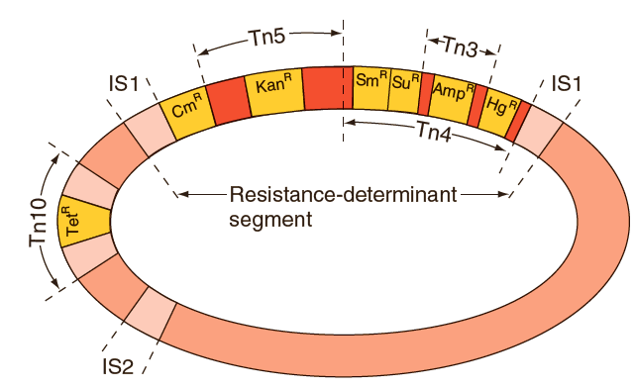
Some plasmids contain multiple antibiotic resistance genes and transposons
Movement of antibiotic resistance genes to the plasmid was facilitated by transposons
Multiple antibiotic resistance genes can be transposed from the plasmid as a unit
Fig. 14.12

Slide 26
Gene transfer in bacteria
Vertical gene transfer occurs in sexually reproducing organisms – traits are transferred from parent to offspring
Lateral (or horizontal) gene transfer – traits are introduced from unrelated individuals or from different species
All are essentially one-way transfers
Donor bacterium provides the DNA that is transferred
Recipient bacterium receives the DNA, which can result in altered phenotype
Three mechanisms of gene transfer:
1) Transformation, 2) Conjugation, 3) Transduction.

Slide 27
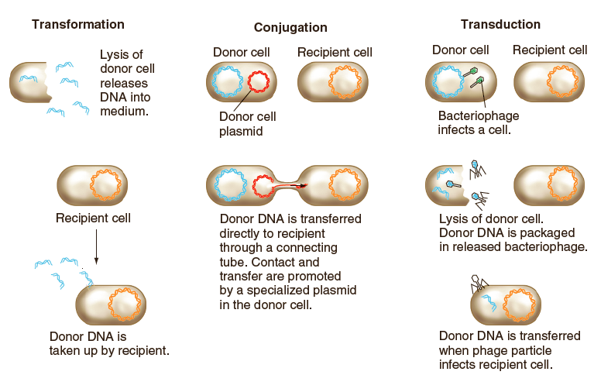
Gene transfer in bacteria: An overview
Transformation
(naked DNA)
Conjugation
(bacterial contact)
Transduction
(by phage)

Slide 28
In transformation, the recipient takes up naked DNA fragments from surrounding environment
Natural transformation occurs in some bacterial species
1% - 5% of cells become competent
Artificial transformation can be accomplished in the lab by damaging recipient cell walls and membrane to allow donor DNA to enter cells
1) Chemically — Treat cells by suspending in calcium
at cold temperatures to make the cells competent
2) Electroporation — Mix donor DNA with recipient
bacteria and subject to very brief high-voltage
shock

Slide 29
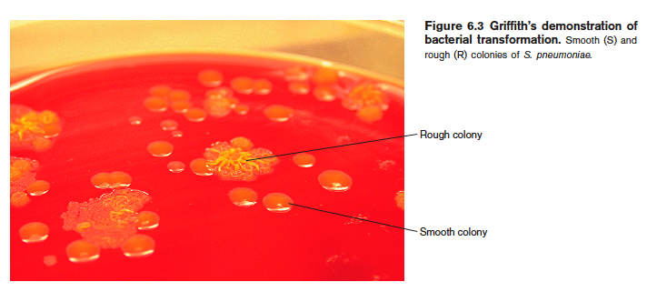
Bacterial transformation demonstrated DNA as the substance of genes
F. Griffith (1928) did experiments with two strains of S. pneumoniae
Differ in colony morphology and biological activity
Smooth (S) strain – virulent
R strain – nonvirulent, mutant
R cells could be transformed by genetic material transferred from dead S cells
Rough
It is a mutant, lacking the enzyme
for capsular polysaccharide
Smooth

Slide 30
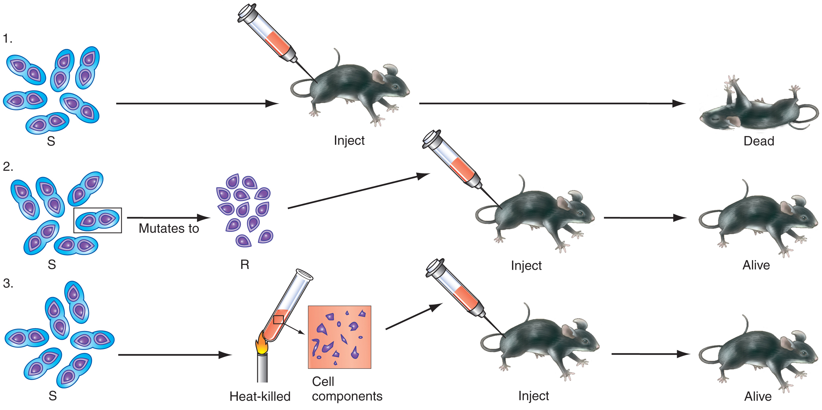
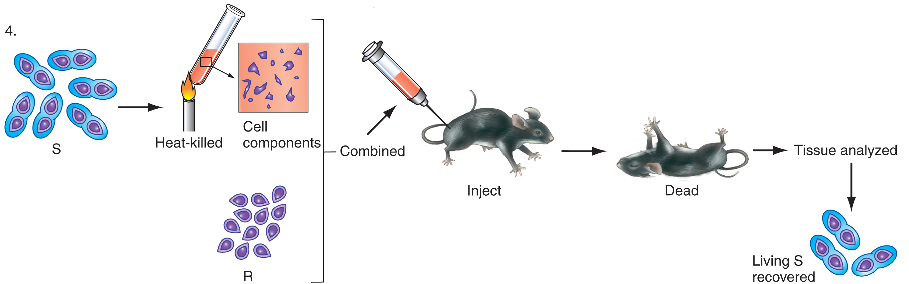
Griffith’s experiment that provided evidence of transformation
Smooth
Dead
Smooth Rough
Alive
Smooth
Alive
Dead
Smooth Rough
Smooth

Slide 31
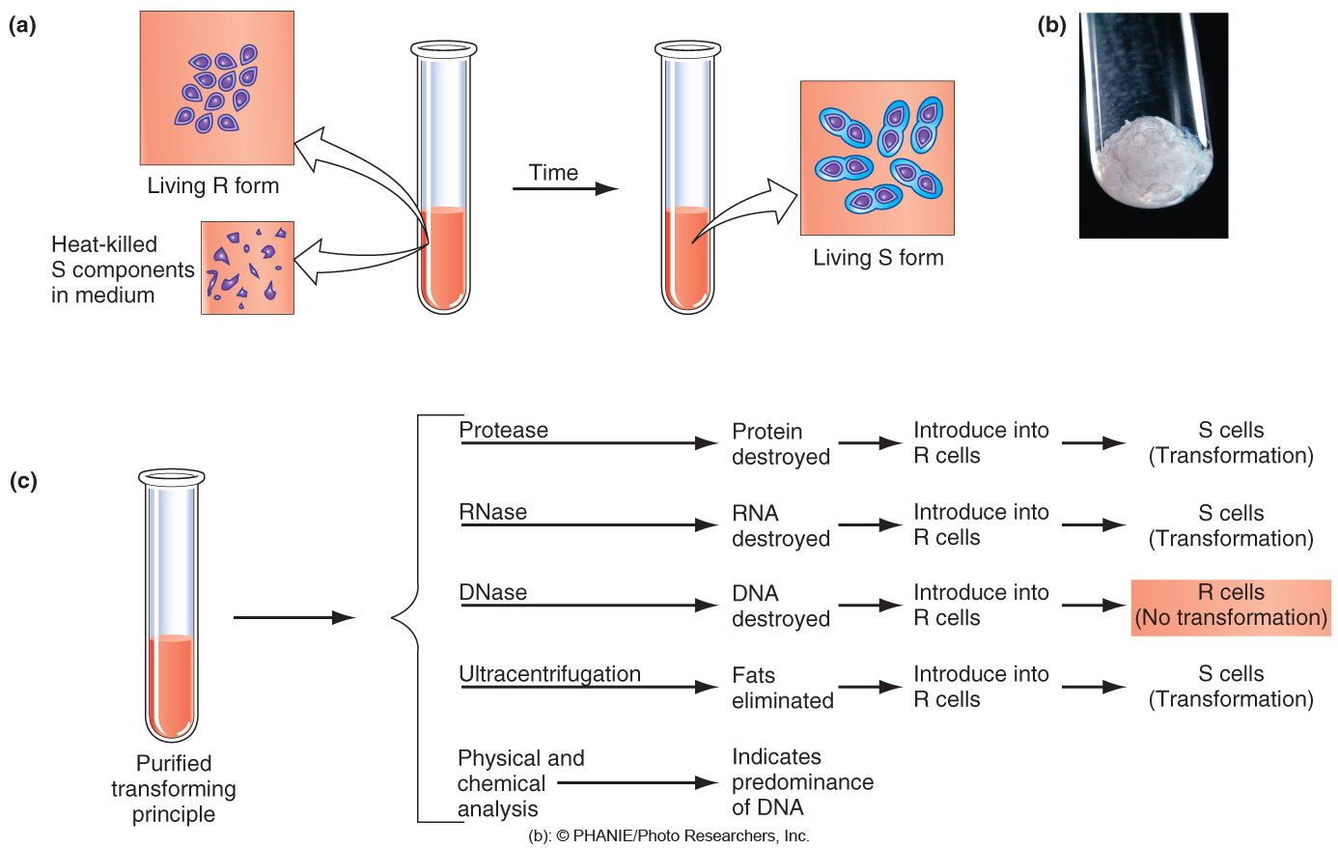
Avery, MacLeod, and McCarty (1944) confirmed that DNA is the transforming principle
DNAse

Slide 32
Natural transformation in B. subtilis
His: Histidine, Trp: tryptophan

Slide 33
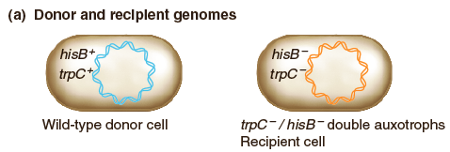
Selecting and screening for transformation
Selection and screening for gene transfer from His⁺ Trp⁺ donor to His⁻ Trp⁻ recipient:
Fig. 14.14a
To select for Trp⁺ transformants, plate on minimal media with histidine and no tryptophan
To select for His⁺ transformants, plate on minimal media with tryptophan and no histidine
To screen for His⁺ Trp⁺ co-transformants, test Trp⁺ transformants and His⁺ transformants for growth on minimal media with neither tryptophan nor histidine
His: Histidine, Trp: tryptophan

Slide 34
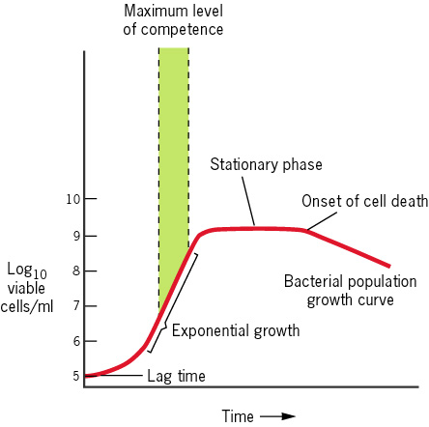
The efficiency of transformation is affected by bacterial status: competence
Competence: the growth stage that the bacteria is able to take up DNA from the media.
Competent cell: The bacterial cells that are in the competence stage.
Competence factor: Enzyme or proteins that promote transformation efficiency.

Slide 35
Co-transformation
1. The up limit of the DNA fragment that can be efficiently transformed is 10 kb～20 kb, accounting for 1/200 of E. coli genome
2. Cotransformation: Genes that are located close to each other in a bacterial species can be simultaneously transformed into other bacterial cells.
3. Genes that are distant from each other have a lower possibility to be transformed into other species at the same time.

Slide 36
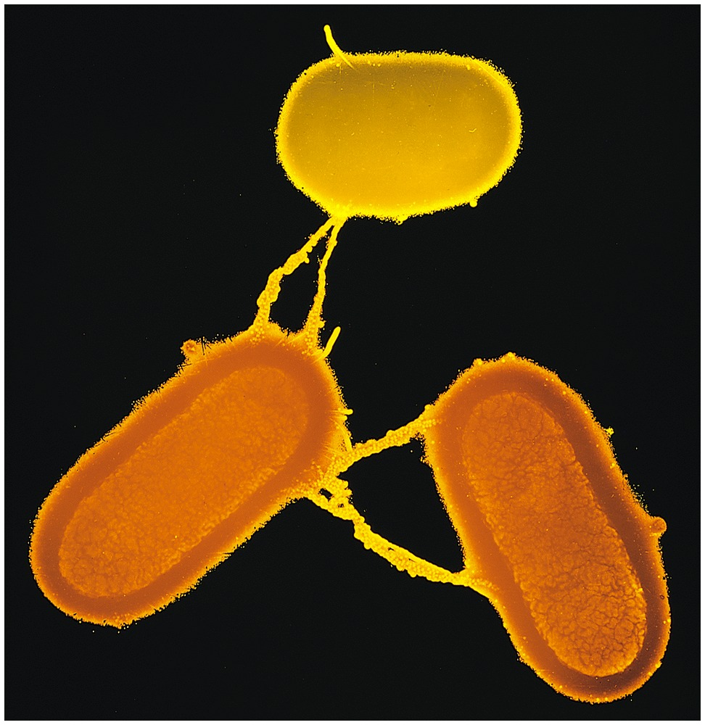
Conjugation (结合) demonstrated by F facor in E. coli

Slide 37
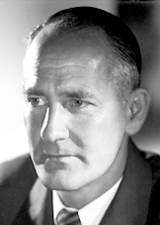
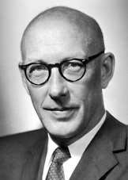
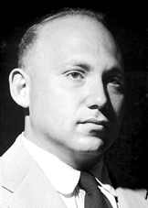
The Nobel Prize in Physiology or Medicine 1958
George Wells Beadle
Prize share: 1/4
Edward Lawrie Tatum
Prize share: 1/4
Joshua Lederberg
Prize share: 1/2
The Nobel Prize in Physiology or Medicine 1958 was divided, one half jointly to George Beadle and Edward Tatum for their discovery that genes have enzymatic activities in the cells, and the other half to Joshua Lederberg "for his discoveries concerning genetic recombination and the organization of the genetic material of bacteria".

Slide 38
Conjugation requires direct cell-to-cell contact
requires methionine
and biotin
requires threonine, leucine, and thiamine
Joshua Lederberg and Edward Tatum (1946)

Slide 39
Conjugation discovered by Joshua Lederberg and Edward Tatum (1946)
Lederberg and Tatum grew the two strains together on supplemented medium. About 1 in every 10⁷ transferred cells proliferated to a visible colony.
To prove cell contact, we have to exclude the following possibilities:
DNA transformation, but not cell contact
Syntrophism, mutual dependence of different types of organisms for the satisfaction of their respective nutritional needs.

Slide 40
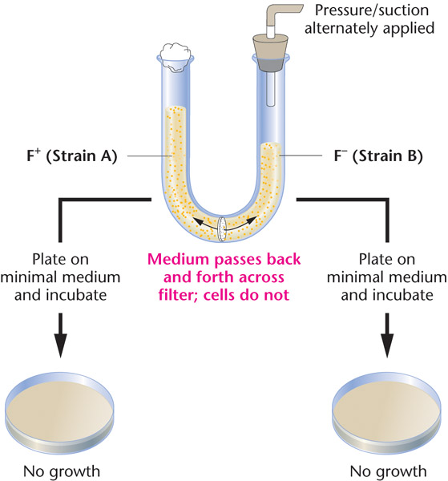
U-tube experiment to prove that bacterial conjugation required direct contact between the two bacterial strains
Prove:
1) Bacteria needs direct contact to each other, no transformation.
2) No syntrophism
Bernard Davis 1950

Slide 41
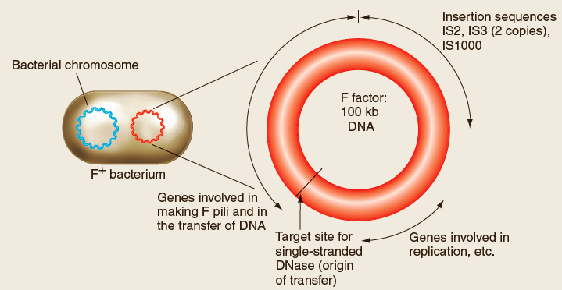
The F plasmid contains genes for synthesizing connections between donor and recipient cells
The F factor (F因子，sex factor) is a circular plasmid that may exist free in the cytoplasm or integrated into the chromosome of E. coli.
F factor contains genes encoding synthesis of pili（菌毛）for cell contact
F factor replicates inside host cell
Fig. 14.16a

Slide 42
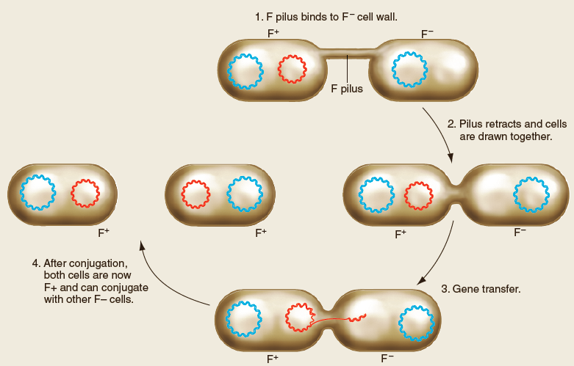
Gene transfer between F⁺ donors and F⁻ recipients during conjugation
Mating only between cell with F (F⁺) and cell without F (F–)
Transfer of F factor is one-way from donor to recipient
Donors for conjugation are F⁺ (carry an F plasmid)
Recipients for conjugation are F⁻ (don't carry an F plasmid)
Fig. 14.16b

Slide 43
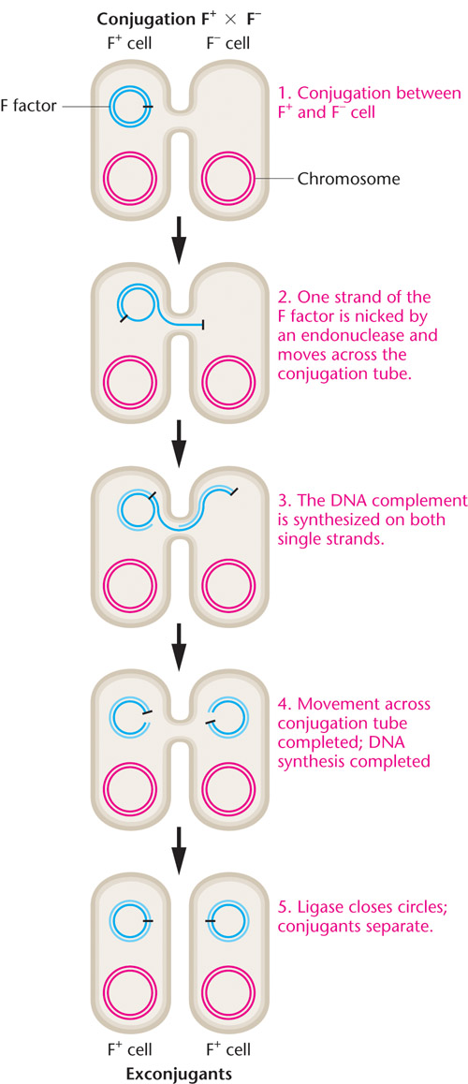
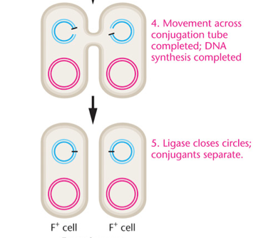
F factor replicated by rolling-circle and duplicate is transferred

Slide 44
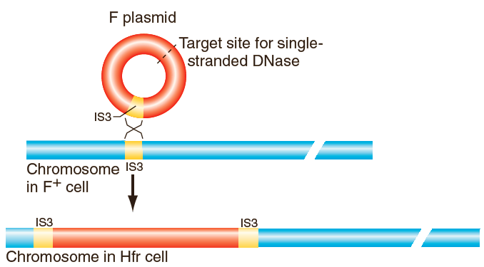
Formation of an Hfr chromosome
F carries one or more insertion sequence elements (IS), which permit homologous recombination with same IS in genome
High frequency recombinant (Hfr) cells are formed when an F plasmid integrates into the bacterial chromosome through recombination between IS elements
Fig. 14.17

Slide 45
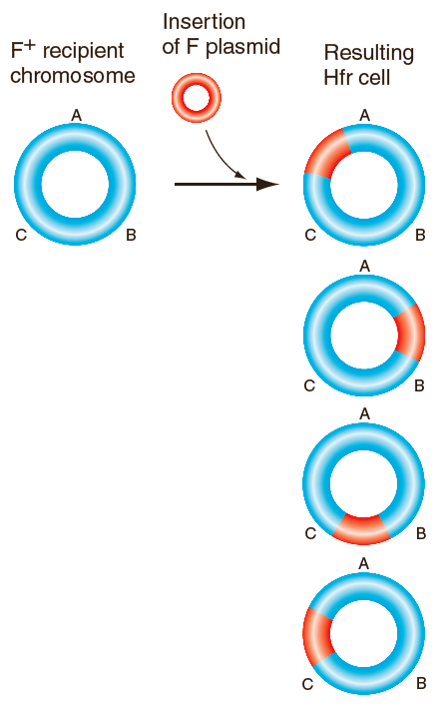
Different Hfr chromosomes
20-30 different Hfr strains can be generated that differ in the location and orientation of the integrated F plasmids
Hfr strains retain all F plasmid functions and can be a donor for conjugation with an F⁻ strain
Fig. 14.18

Slide 46
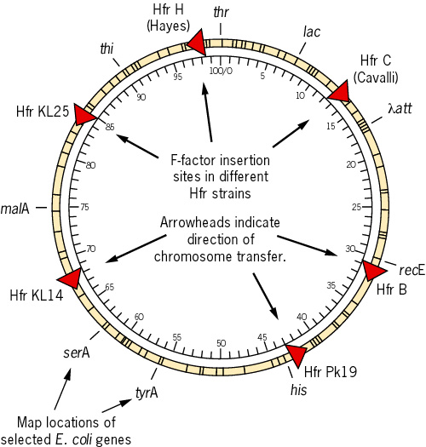
Some of the sites of F-factor integration in the E. coli chromosome
The arrows indicate the direction of transfer.
46

Slide 47
Gene transfer between Hfr donors and F⁻ recipients
1
4
5
2
3
Chromosomal genes located next to F plasmid sequences are transferred to the recipient

Slide 48
After conjugation, crossovers are needed to integrate genes from the donor fragment into the recipient’s chromosome

Slide 49
Summary: Two types of DNA transfer during conjugation
49

Slide 50
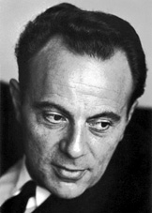
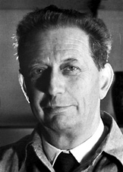
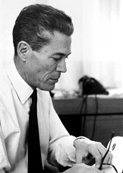
The Nobel Prize in Physiology and Medicine 1965
François Jacob André Lwoff Jacques Monod
"for their discoveries concerning genetic control of enzyme and virus synthesis".
Jacob and Monod originated the idea that control of enzyme levels in all cells occurs through regulation of transcription.

Slide 51
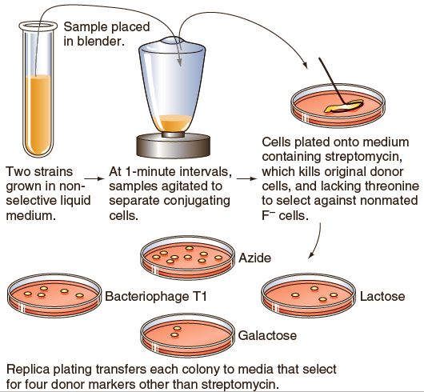
Interrupted-mating experiments with Hfr and F⁻ strains by F. Jacob and E. Wollman in 1957
Hfr: thr⁺ leu⁺ azi^{s} ton^{s} lac⁺ gal⁺ str^{s}
F－: thr－leu－azi^{r} ton^{r} lac－gal－str^{r}
Mix Hfr and F⁻ strains
After timed intervals, mating is interrupted and cells are plated on selective medium to recover recombinants
Kill the Hfr donor cells with a medium containing streptomycin
Select F⁻ cells with medium lacking threonine.
5. Determine time and recombination frequencies

Slide 52
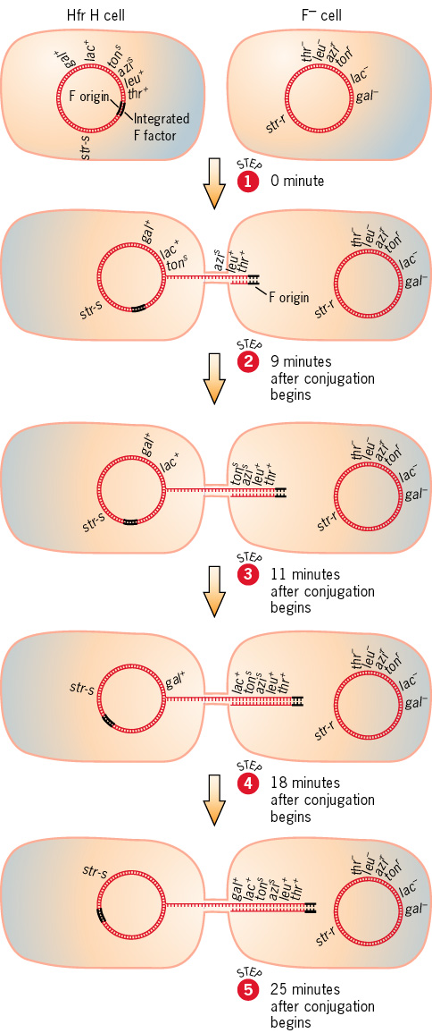
During conjugation, Hfr strains transmit host chromosome to F– in linear manner
Single- stranded DNA transfer begins from the site at which the F plasmid is inserted (site O)
The transfer rate is constant, about 1% of chromosome per minute
The transfer process will generally stop before the farther- most genes are transferred
Genes close to O are included in higher number of exconjugants.
Genes farther to O are included in fewer exconjugants.
Fig. 14.20

Slide 53
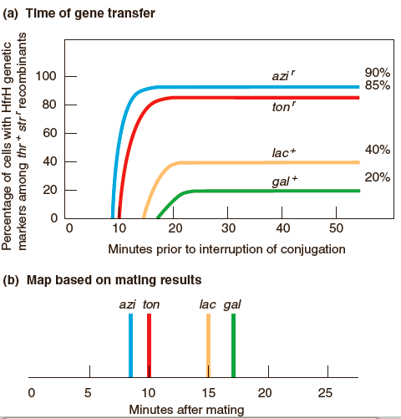
Mapping genes by interrupted-mating with Hfr and F⁻ strains
(a) Time of gene transfer
Genes are mapped according to time of appearance of recombinants.
Genes enter F⁻ early will have higher frequency in the F⁻ recombinant
(b) Map based on mating results

Slide 54
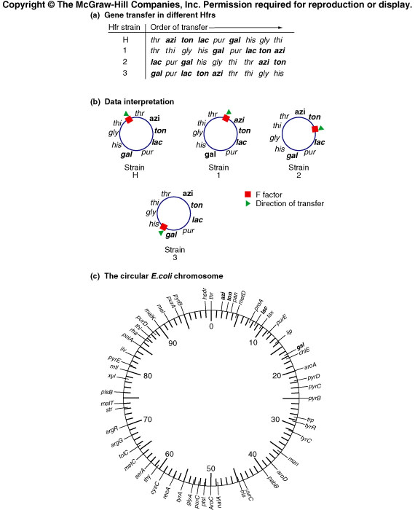
Partial genetic map of the E. coli chromosome
The resolution of genetic map by interupted-mating is 2 min。

Slide 55
Recombination analysis improves accuracy of map
Interrupted mating experiments accurate to only 2 minutes
Frequency of recombination between genes is more accurate
Considering only exconjugants that have all of the genes to be mapped (select for the last gene transferred)
Consider as a three-point cross

Slide 56
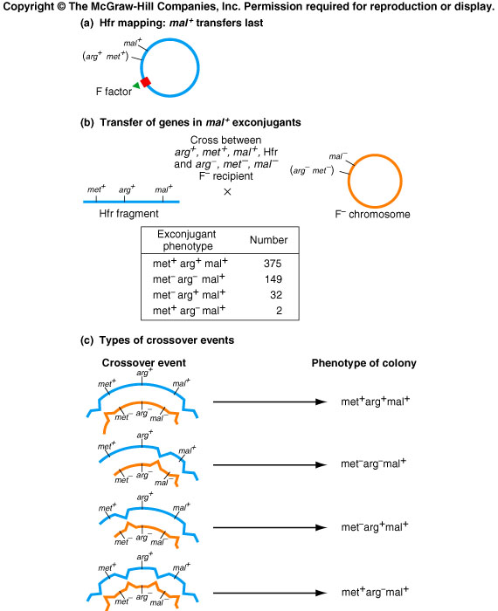
Mapping genes using a three-point cross

Slide 57
Faulty out-looping produces F', a F plasmid that contains genomic DNA
F’ plasmids replicate as discrete circles of DNA inside host cells.
Transferred in same manner as F plasmids
A few chromosomal genes will always be transferred as part of the F’ plasmid
Can create partial diploids（部分二倍体）
Fig. 14.17 c

Slide 58
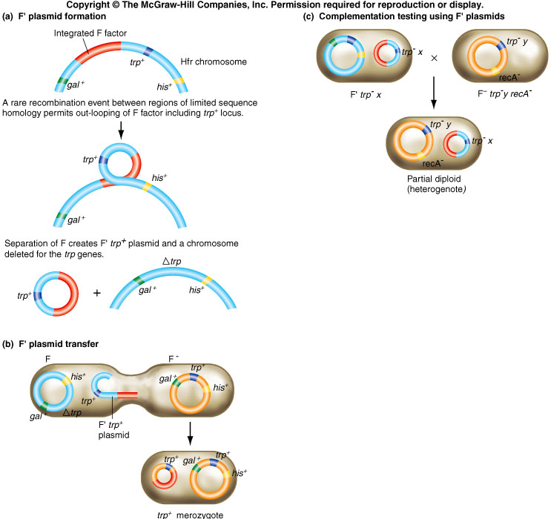
F’ plasmids can be used for complementation studies
Creation of a heterogenote
Phenotype of partial diploid establishes whether mutations complement each other or not
Trp: tryptophan
Fig. 14.17 c

Slide 59
In transduction, a phage transfers DNA from a donor bacterium to a recipient bacterium
An infecting phage injects DNA through its core structure into the cell.

Slide 60
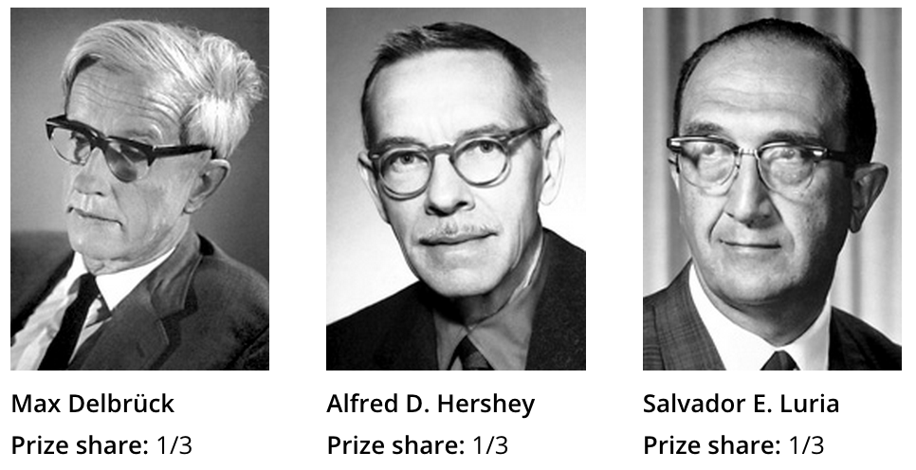
The Nobel Prize in Physiology or Medicine 1969
For work on the replication mechanism and genetics of viruses
The “phage group”: Hershey and Luria found r and h mutants of phage. Delbruck and Hershey developed phage recombination technique

Slide 61
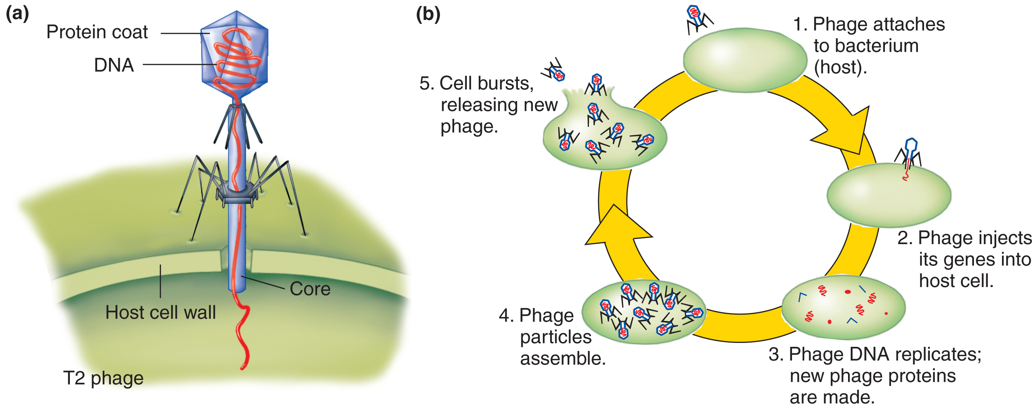
Structure and life cycle of bacteriophage T2 (virulent)
Bacteriophages (aka phages) are viruses that infect, multiply in, and kill various species of bacteria
Widely distributed in nature
Most bacteria are susceptible to one or more phages

Slide 62
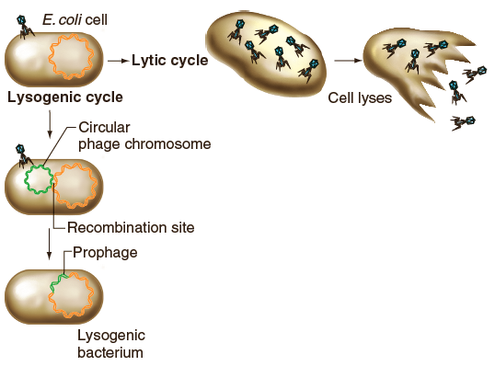
Lytic and lysogenic modes of reproduction
Lytic cycle: produce viral proteins, cell burst
Lysogenic cycle: phage DNA inserted into bacterial chromosome, do not produce the viral proteins needed for more virus particles
Fig. 14.24

Slide 63
Virulent and temperate phages
Virulent phages – always enter lytic cycle after infecting cells, multiply rapidly, and kill cells
Temperate phages – can enter either lytic cycle or enter an alternative lysogenic cycle
Transduction – process by which a phage transfers DNA from one host cell to another host cell

Slide 64
The lytic cycle of phage multiplication: cell lysis and release of progeny phage
1. Phage injects its DNA into bacteria
2. Phage proteins are expressed and take over protein synthesis and DNA replication machinery of infected cell
3. Phage DNA replication
4. Phage particles are assembled with phage DNA and phage protein
5. Infected cell bursts (lyses) and releases 100-200 new viral particles able to infect other cells
Lysate – the population of phage particles released from host bacteria at the end of the lytic cycle

Slide 65
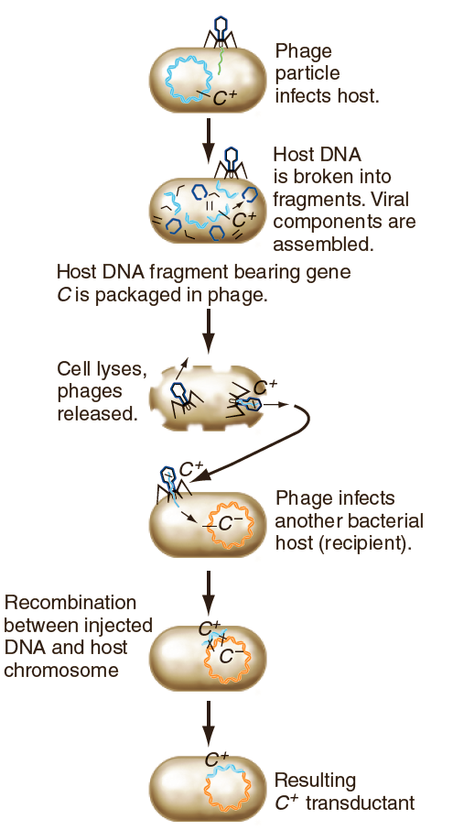
Generalized transduction
1. Incorporation of random fragments of bacterial DNA from donor into bacteriophage particles
2. DNA from donor cell injected into infected recipient cell
3. Transduced chromosomal DNA recombines into homologous DNA in recipient
Fig. 14.22

Slide 66
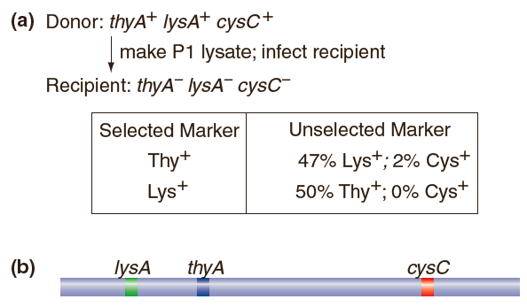
Mapping genes by cotransduction frequencies
In generalized transduction, up to 90 kb of DNA (~ 2% of E. coli genome) can be transduced by phage into recipient bacteria.
Frequency of cotransduction is higher for genes that are close together compared to genes that are further apart
Fig. 14.23

Slide 67
From high cotransduction frequencies, close linkage is inferred
A genetic map of the purB-to-cysB region of E. coli determined by P1 cotransduction. The numbers given are the averages in percent for cotransduction frequencies obtained in several experiments. The values in parentheses are considered unreliable.

Slide 68
Temperate phages
Choice of lytic or lysogenic cycle depends on many factors, including environmental conditions
Lysogen – bacteria that harbor an integrated temperate phage
Prophage – temperate phage that has integrated into host chromosome
Bacteriophage lambda (λ) is the most commonly used temperate phage

Slide 69
Integration of the phage DNA initiates the lysogenic cycle
Recombination between att sites on phage λ and the bacterial chromosome allows integration of the prophage
Fig. 14.26a

Slide 70
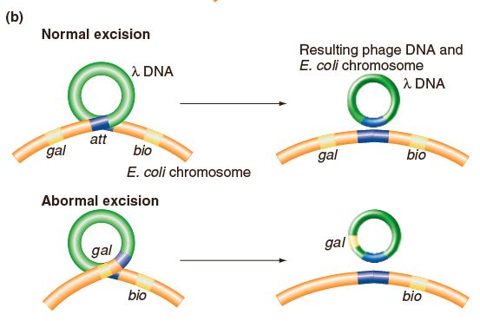
Specialized transduction: abnormal excision of a prophage from a lysogen
1. Abnormal excision produces a specialized transducing phage
2. Bacterial DNA adjacent to integration site can be packaged with viral DNA and then transferred to a recipient cell
Fig. 14.26b

Slide 71
Comparison of generalized and specialized transduction
When donor DNA is packaged by phage:
Generalized transduction – during lytic cycle
Specialized transduction – during transition from lysogenic to lytic cycles
Which donor DNA can be packaged with phage:
Generalized transduction – any bacterial gene Specialized transduction – only those bacterial genes near the integration site of the phage

Slide 72
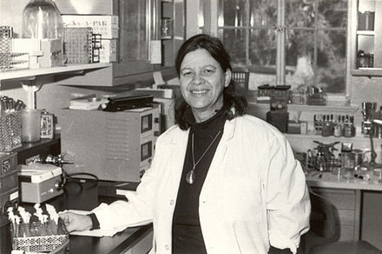
Joshua and Esther Lederberg
Nobel prize 1958, the other half to Joshua Lederberg "for his discoveries concerning genetic recombination and the organization of the genetic material of bacteria".
1946 Joshua Lederberg and Tatum discovered bacterial
conjugation
1951 Joshua Lederberg and Zinder showed DNA can be
transferred by generalized transduction.
1956, M. Laurance Morse, Esther Lederberg and Joshua
Lederberg also discovered specialized transduction.
1956 Esther Lederberg also discovered fertility factor F, later
publishing with Joshua Lederberg and Luigi Luca Cavalli-
Sforza
Joshua Lederberg
Esther Lederberg

Slide 73
Genomic islands originated from transfer of foreign DNA
Large segments of DNA (10-200 kb in size)
G+C content is different from the rest of the genome
Presence of direct repeats at each end
Found at sites where tRNAs genes are located because tRNAs are highly conserved and promote homologous recombination
Contain integrase genes and sites for integration
Genomic islands carry many different types of genes that are involved in newly derived functions.
Some of these included genes encoding new metabolic enzymes, antibiotic resistance, toxins, or enzymes to degrade poisonous substances in the bacteria’s environment.

Slide 74
Pathogenicity islands contain many genes involved in causing disease
1. Pathogenic determinants are often clustered in a subtype of genomic islands, called pathogenicity islands.
2. With such an arrangement, the lateral transfer of a “package” of genes from one species to another can turn a nonpathogenic strain into a pathogenic strain.
3. Pathogenicity islands including genes for adhesion to eukary- otic (host) cells, toxins, and secretion systems that allow the bacteria to transport substances into eukaryotic cells that disrupt the cells

Slide 75
Pathogenicity islands in E. coli
E. coli is the most abundant organism in the human colon and coexists peacefully within us, for the most part.
2. E. coli strain O157:H7 – causes diarrhea or meningitis
Encodes proteins for attachment to epithelial cells, changes to cytoskeleton, loss of fluid, toxin from Shigella that damages kidneys and intestines
The DNA sequence shows that this toxin gene was transferred into E. coli by bacteriophage transduction and became part of the large pathogenicity island

